Slide 1
FHIR, Commercial and Industrial Research

Slide 2
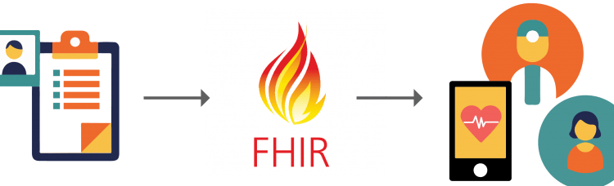
Introducing the HL7 FHIR
FHIR (Fast Healthcare Interoperability Resources) – standard for transferring healthcare information electronically.
FHIR is suitable for use in a wide variety of contexts – mobile phone apps, cloud communications, EHR-based data sharing, server communication in large institutional healthcare providers, and much more.
FHIR can be used independently or together with existing standards.

Slide 3
Why do we need FHIR?
Healthcare records are increasingly becoming digitized. Patients' electronic health records must be available, reliable, and understandable.
To support some network communication, machine learning and algorithmic processing, the data must be structured and standardized.
FHIR is a relatively new specification, informed by years of lessons around requirements, gained through earlier standards, HL7, RIM, CDA.
Importantly, FHIR can be used as a stand-alone data exchange standard, but is also used with existing widely used standards. (Compatibility)

Slide 4
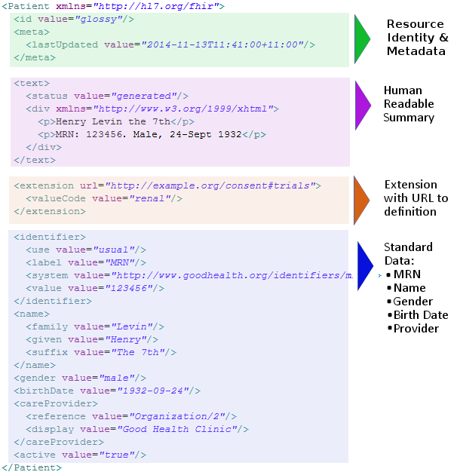
FHIR vs other standards
Fast and easy to implement
Multiple available libraries - helps to kick-start development.
Strong foundation in Web standards (XML, JSON , HTTP, OAuth, etc.)
Supports HTTP-based RESTful architectures.
Well written, free documentation

Slide 5
FHIR Modules
Security Module
Administration Module
Clinical Module
Medication Module
Diagnosis Module

Slide 6
FHIR Components
The basic component of FHIR is a Resource, and all exchangeable content is defined as resource. Resources can be represented by XML or JSON. The resources have been defined so far have the following characteristics:
URL
Common metadata
Overview of human readable file
A set of defined common data elements
An extensible framework

Slide 7



Sensors in the Industry
114 years of manufacturing electrical and other devices.
Provides full range of sensors and switches required in smart infusion pumps.
Has a great manual for each sensor with thorough guidelines.
Big emphasis on sensors for medical pump applications.
Easy integration and 20 years of proven performance.
TE offers ISO 13485 certification and FDA registration for various sensors and assemblies.
Provides a wide range of advanced sensors and switches, including different load cells.
30-year presence in the industry – known for exceptional accuracy and long-term performance.

Slide 8
Different Force Sensors
S256 Force Sensor (SMD)
Long term stability
Sensitive and accurate
Overload protection
Compact and low power consumption
Low hysteresis
MicroForce FMA Series (Honeywell)
Piezoresistive based
Calibrated with ASIC
Direct mechanical coupling
Overload protection
Compact
Enhanced accuracy
Diagnostic functions

Slide 9
Different Pressure Sensors
B354 Pressure Sensor (SMD)
Long term stability and low power consumption
Stainless steel
Can be used with pressure fittings
Durable
MicroPressure MPR Series (Honeywell)
Piezoresistive silicon pressure sensor
Calibrated with ASIC
Compact and low power consumption

Slide 10
THANK YOU!

